Slide 1


REENGINEERING
LAGACY
SYSTEMS WITH
SOFTWARE METRICS
Presented by: AFAQ-UR-REHMAN , HASNAT AHMAD

Slide 2

INTRODUCTION
A software metric is a measure of software characteristics which are measurable or countable.
Software metrics are valuable for many reasons, including
1- Measuring software performance.
2- Planning work items .
3- Measuring productivity.
4- Improvement of software systems.

Slide 3

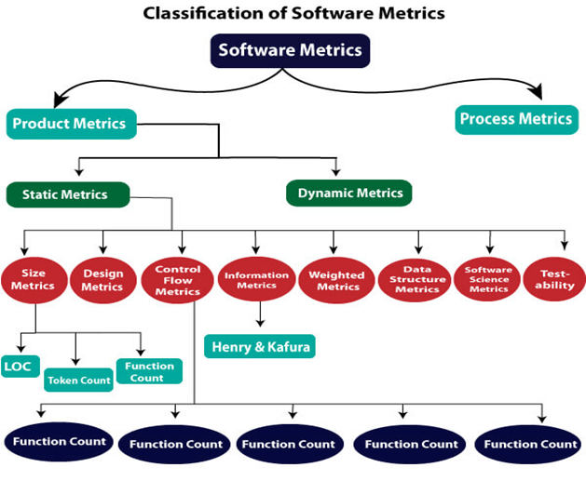


TYPES OF SOFTWARE METRICS

Slide 4

ROLE OF SOFTWARE METRICS IN REENGINEERING
Provide objective measurements to identify quality issues and prioritize reengineering efforts.
Metrics enable organizations to assess the technical quality and business value of legacy systems.
Organizations can quantify the costs of changes and evaluate the return on investment of reengineering projects
Software metrics has provided a structured approach to reengineering, improving decision-making and outcomes.
Metrics-based reengineering methodologies lead to more efficient and successful projects.

Slide 5

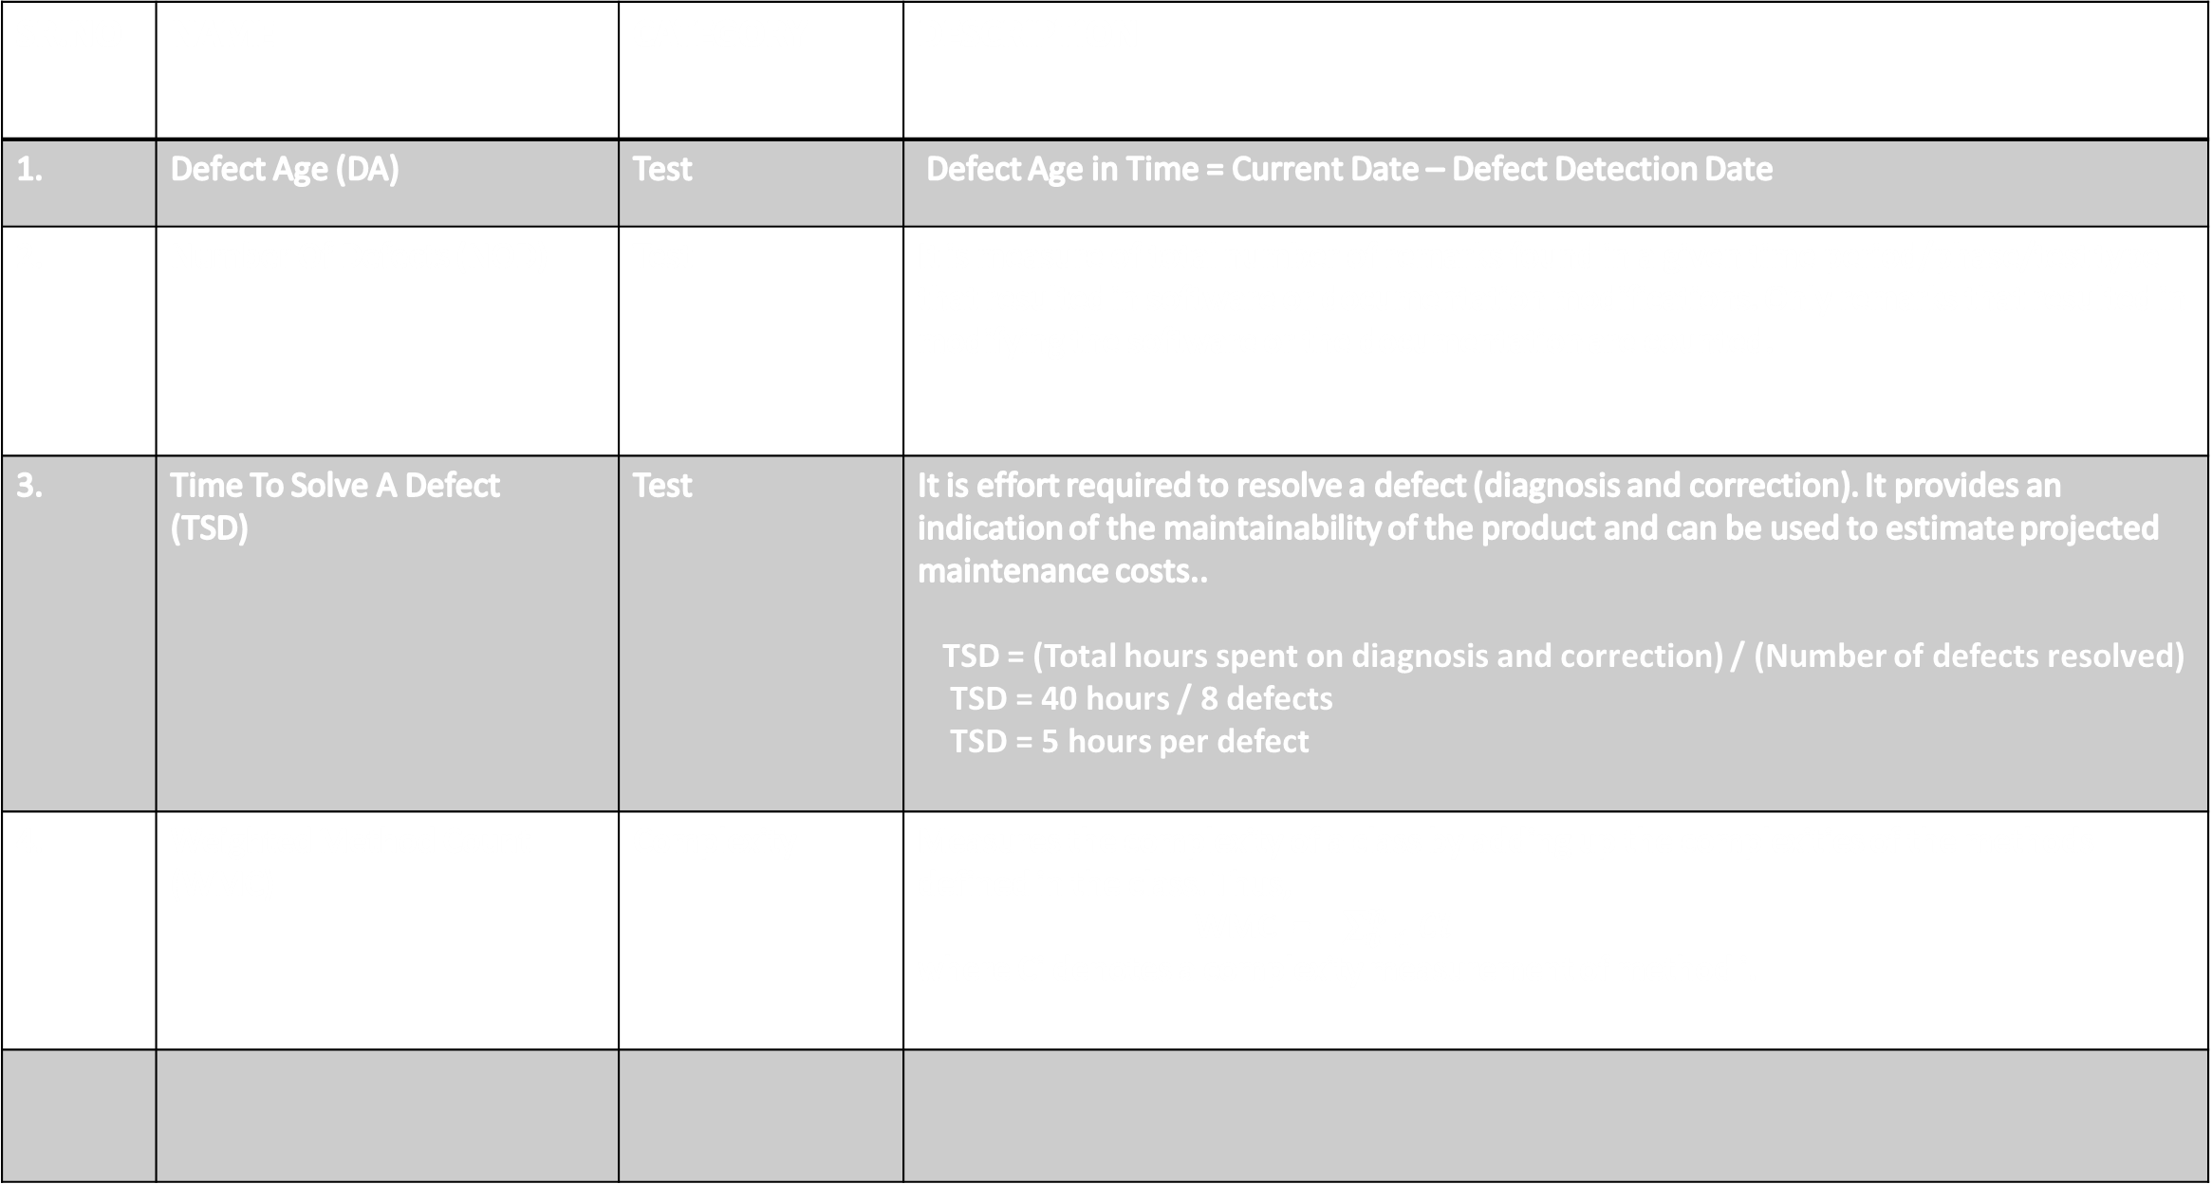
METRICS USED IN REENGINEERING PROCESS
SR.NO | NAME | CATEGORY | DESCRIPTION
1. | Defect Age (DA) | Test | Defect Age in Time = Current Date – Defect Detection Date
2. | Number Of Defects (NOD) | Test | It is measure of total number of remarks found in a given time period/phase/test type that resulted in software or documentation modifications. Only remarks that resulted in modifying the software or the documentation are counted.
3. | Time To Solve A Defect (TSD) | Test | It is effort required to resolve a defect (diagnosis and correction). It provides an indication of the maintainability of the product and can be used to estimate projected maintenance costs.. TSD = (Total hours spent on diagnosis and correction) / (Number of defects resolved) TSD = 40 hours / 8 defects TSD = 5 hours per defect
4. | Weighted Method Count (WMC) | Complexity | Measures the complexity of a class by adding up the complexities of the methods defined in the class. Thus, WMC = $\sum_{i=1}^{n}{Ci}$ where Ci denotes a complexity measurement of method i.

Slide 6
METRICS USED IN REENGINEERING PROCESS
SR.NO | NAME | CATEGORY | DESCRIPTION
5. | Lines Of Code (LOC | Complexity | Measures the size of a piece of source code by counting its lines. Since the size of some source code can be seen as an indicator of its complexity,
6. | Number of Children (NOC) | Complexity | The Number of Children (NOC) represents the number of immediate subclasses subordinated to a class in the class hierarchy. This metric may be used in order to detect misuses of subclassing
7. | Coupling between Objects | Coupling | CBO = number of classes to which a class is coupled
8. | Maintainability Index | Cost | It is also used to calculate maintainability of the software after changes to compare it with previous software. Maintainability of the software can be calculated by using following Equation MI = MAX(0,(171 - 5.2 * ln(Halstead Volume) - 0.23 * ( Cyclomatic Complexity ) - 16.2 * ln(Lines of Code))*100 / 171) 0-9 = Red 10-19 = Yellow 20-100 = Green

Slide 7
METRICS USED IN REENGINEERING PROCESS
SR.NO | NAME | CATEGORY | DESCRIPTION
9. | Defect Cost (DC) | Cost | DC = (Defect age in years) (Lines affected by defect) ------------------------------- X ----------------------------------- (Soft age in years) Total number of lines
10. | Fault Cost (FC) | Cost | FC can be calculated by calculating ratio between mean time to maintenance and time between last two maintenance tasks. When failures become frequent above ratio increases and hence value of FC increases. FC is taken as 0 when software is maintained first time. FC = mean time to maintenance / Time between last 2 maintenance
Notes:
Halstead Metrics -The volume and difficulty of understanding a system’s codebase. Ideally, new software developers should be able to jump in and understand your code with ease.

Slide 8
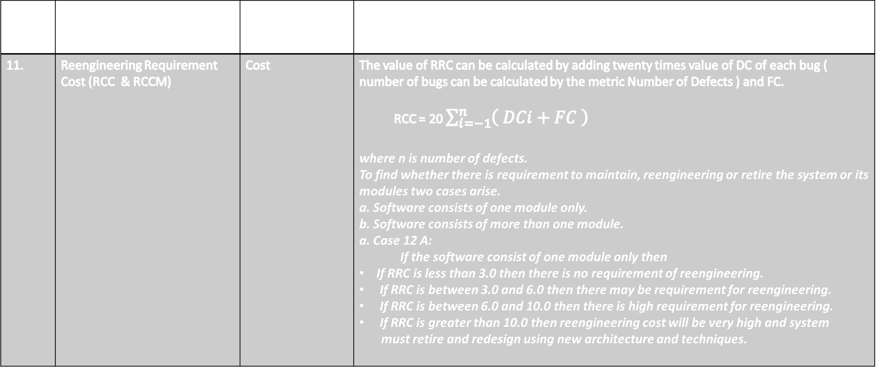
METRICS USED IN REENGINEERING PROCESS
SR.NO | NAME | CATEGORY | DESCRIPTION
11. | Reengineering Requirement Cost (RCC & RCCM) | Cost | The value of RRC can be calculated by adding twenty times value of DC of each bug ( number of bugs can be calculated by the metric Number of Defects ) and FC. RCC = 20 $\sum_{i=−1}^{n}{\left( DCi+FC \right)}$ where n is number of defects. To find whether there is requirement to maintain, reengineering or retire the system or its modules two cases arise. a. Software consists of one module only. b. Software consists of more than one module. a. Case 12 A: If the software consist of one module only then If RRC is less than 3.0 then there is no requirement of reengineering. If RRC is between 3.0 and 6.0 then there may be requirement for reengineering. If RRC is between 6.0 and 10.0 then there is high requirement for reengineering. If RRC is greater than 10.0 then reengineering cost will be very high and system must retire and redesign using new architecture and techniques.

Slide 9
METRICS USED IN REENGINEERING PROCESS
SR.NO | NAME | CATEGORY | DESCRIPTION
11. | Reengineering Requirement Cost (RCC & RCCM) | Cost | b. Case 12 B: Reengineering Requirement Metric calculates whether there is requirement to maintain the software, reengineer software or retire software. It also calculates if there is a requirement to reengineer software then whether whole software requires reengineering or some part of software require reengineering. In this metric four variables, efect Cost (DC), Fault Cost (FC), Reengineering Requirement Cost (RRC) and Reengineering Requirement Cost of Module (RRCM) are used. If software consists of more than one module and if the value of RRC is between 3.0 and 6.0 then each module of the software is checked by adding half of RRC of whole software to RRC of ith module to calculate Reengineering Requirement Cost of Module i (RRCM). RCCMi = ½ RCC + RCC ( Mi ) If RRCM is less than 6.0, then there is no requirement of reengineering. If RRCM is between 6.0 and 10.0, then there is requirement to reengineer the module. If RRCM is greater than 10.0 then reengineering cost will be very high and new module should be redesign.

Slide 10
CASE STUDY
Software (Stock Management) use to manage the stock of cast iron foundry is taken as case study. Software
is developed in C++. It is used to keep track of stock of hard coke and pig iron in an iron foundry. It consists of
3 modules and has 1366 LOC. The first module main is used to manage the other 2 modules. Second module
Hard Coke is used to keep track of stock of hard coke and third module Pig Iron used to keep track of stock of
pig iron. This software is developed with little documentation and lot of extra variables and statements. So there
is requirement to look into the source code again.
The software of Stock Management consists of 1366 statements, out of which 257 needs to be changed.
We need to calculate DC. In this case ratio between defect age in year and software age in year is 1 as the age of software is less than 1 year.
Since software is changed first time, so FC value of the software is 0.0.

Slide 11
CASE STUDY
SR.NO | NAME | LOC | DC | FC | RCC | RESULT
1. | Stock management | 1366 | 257/1366= 0.188 | 0 | 3.76 | Reengineer

Slide 12
CASE STUDY
SR.NO | NAME | LOC | DC | FC | RCC | RESULT
1. | Main | 137 | 1.24 | 0 | 2.48 | Maintain
2. | Hard Coke | 668 | .212 | 0 | 4.24 | Reengineer
3. | Pig Iron | 561 | 174 | 0 | 3.49 | Maintain

